Slide 1

CMR Technical Campus
Department of Information Technology
Major Project Stage-II
Review-2
Project Title: Customer Support Dataset With Multi-Intent Annotations for Conversational AI
Project Supervisor:
Name: Mrs K.Supriya Suhasini
Designation: Assistant Professor
Presented By:
Batch No: 18
1.H.No: 227R1A1286 Name: G. Shivani
2.H.No: 227R1A12B7 Name: N.Thriveni
3.H.No: 227R1A1282 Name: D.Akhilesh

Slide 2
CONTENTS
Introduction and Overview
Existing system
Existing system - disadvantages
Proposed system
Proposed system – advantages
Hardware/Software requirements
Novelty of the project
System Architecture
Modules
UML Diagrams
Source Code
Results
Conclusion & Enhancement
References
GitHub Link

Slide 3
INTRODUCTION AND OVERVIEW
Traditional customer support systems rely on manual intent annotation, which is time-consuming, inconsistent, and difficult to scale when handling large volumes of customer queries. To address these challenges, this project proposes an advanced NLP-based customer support framework using a multi-intent annotated text dataset. The system integrates MiniLM embeddings for contextual feature extraction, SMOTE for handling data imbalance, and a DNN-assisted KNN classifier to accurately predict both the intent and category of customer queries. The proposed model is further deployed within a real-time chatbot interface, enhancing automation, scalability, response accuracy, and overall customer satisfaction in modern customer support environments.

Slide 4
EXISTING SYSTEM
Customer queries are handled primarily by human agents through calls, emails, or messages.
Intent identification and categorization are performed manually based on agent experience and judgment.
Exploratory data analysis and reporting are carried out using spreadsheets, or manual records.
Classification follows rule-based or keyword-based approaches (e.g., identifying keywords like billing or technical).
Performance metrics and analytics are generated periodically through manual counting and report preparation.

Slide 5
EXISTING SYSTEM -DISADVANTAGES
Lack of Scalability: Unable to efficiently handle large volumes of customer queries simultaneously.
High Error Rate: Manual annotation and human judgment lead to inconsistent intent classification.
Time-Consuming Process: Data analysis, reporting, and query resolution require significant manual effort.

Slide 6
PROPOSED SYSTEM
The proposed system automates customer support using Machine Learning and NLP for accurate intent and category classification.
Customer queries are first preprocessed using NLP techniques such as text cleaning, tokenization, stopword removal, and lemmatization.
MiniLM transformer embeddings are used to extract rich semantic features from text.
Machine learning models including DTC, KNN, and Naïve Bayes, along with DNN-based feature refinement, are applied for classification.
A multi-output classification approach predicts both Intent and Category, with SMOTE used to handle class imbalance.
The trained model is integrated into a real-time chatbot for automated and instant customer responses.

Slide 7
PROPOSED SYSTEM ADVANTAGES
High Accuracy: Advanced embeddings and DNN-assisted learning improve intent prediction accuracy.
Scalability: Efficiently handles large volumes of customer queries without manual intervention.
Reduced Operational Cost: Minimizes dependency on human agents through automation.

Slide 8

HARDWARE & SOFTWARE
REQUIREMENTS
HARDWARE REQUIRMENTS :
Processor : Intel i5
Memory : 1 TB (storage)
RAM : 8 GB
SOFTWARE REQUIRMENTS :
Python : 3.12.0
OPerating System : Windows
Backend :Flask Web Application

Slide 9
NOVELTY OF THE PROJECT
The project introduces a hybrid MiniLM–DNN–KNN model that combines transformer-based embeddings, deep learning feature refinement, and distance-based classification for improved intent detection.
It supports multi-intent and category prediction, enabling better contextual understanding compared to traditional single-intent systems.
A DNN-based feature selection approach is used to reduce noise and dimensionality without increasing model complexity.
The use of SMOTE effectively handles class imbalance, improving performance for minority intent classes.
The model is integrated into a real-time chatbot system, making it scalable, efficient, and practical for modern customer support applications.

Slide 10
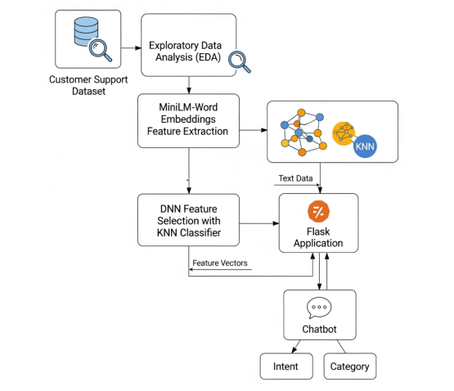
SYSTEM ARCHITECTURE

Slide 11
MODULES
1. Feature Extraction Module:
Converts input text into numerical feature vectors using MiniLM embeddings.
Captures semantic and contextual meaning of customer queries.
Provides a rich feature base for accurate intent classification.
2. Feature Selection and Classification Module:
Deep Neural Network (DNN) selects the most relevant features from embeddings.
K-Nearest Neighbor (KNN) algorithm classifies the intent based on selected features.
Enhances the system’s prediction accuracy and efficiency.

Slide 12
MODULES
3. Flask Application Module
Acts as the backend framework connecting all components.
Manages communication between the model and the chatbot interface.
Ensures smooth data flow and real-time response generation.
4. Chatbot Module
Serves as the user interaction interface for query input and response display.
Utilizes classified intents and categories to respond intelligently.
Provides automated and AI-driven customer support.
5. Exploratory Data Analysis (EDA) Module
Analyzes and visualizes the customer support dataset before training.
Helps identify patterns, correlations, and data distribution.
Ensures high-quality and balanced data for feature extraction.

Slide 13
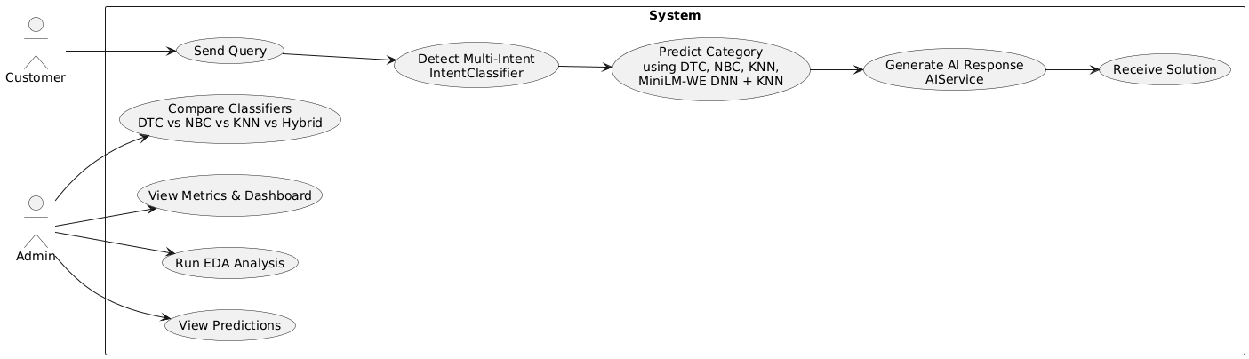
USE CASE DIAGRAM

Slide 14
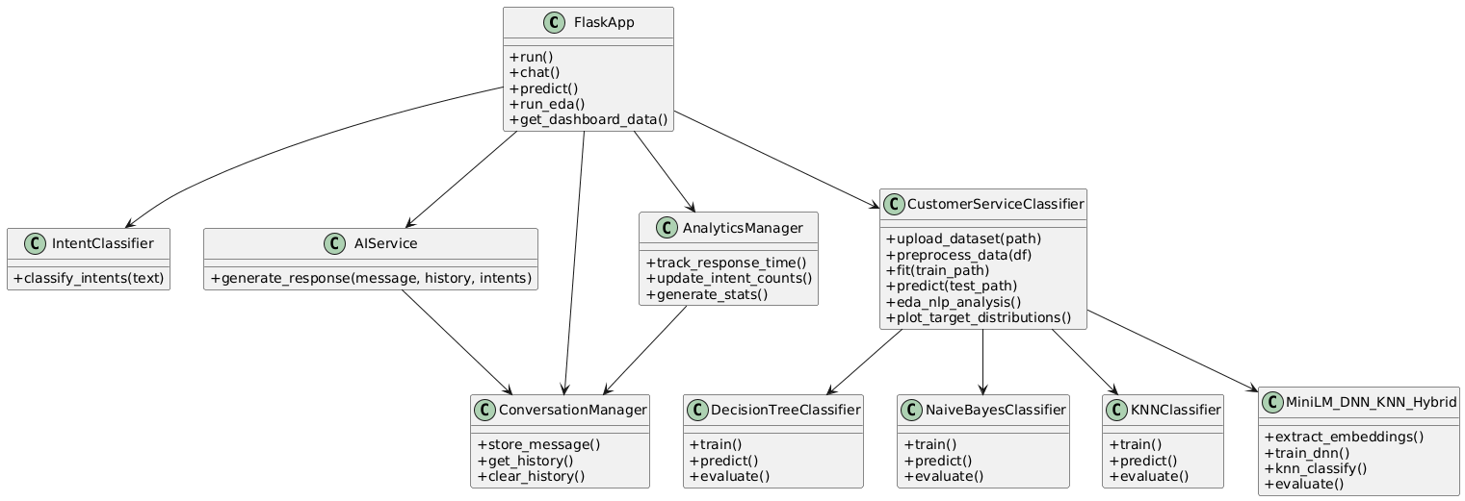
CLASS DIAGRAM

Slide 15
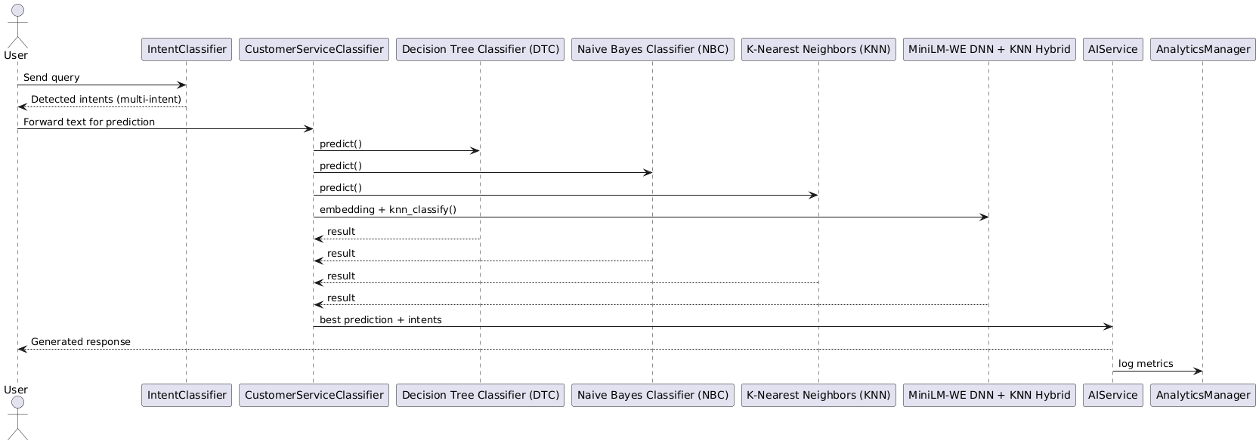
SEQUENCE DIAGRAM

Slide 16
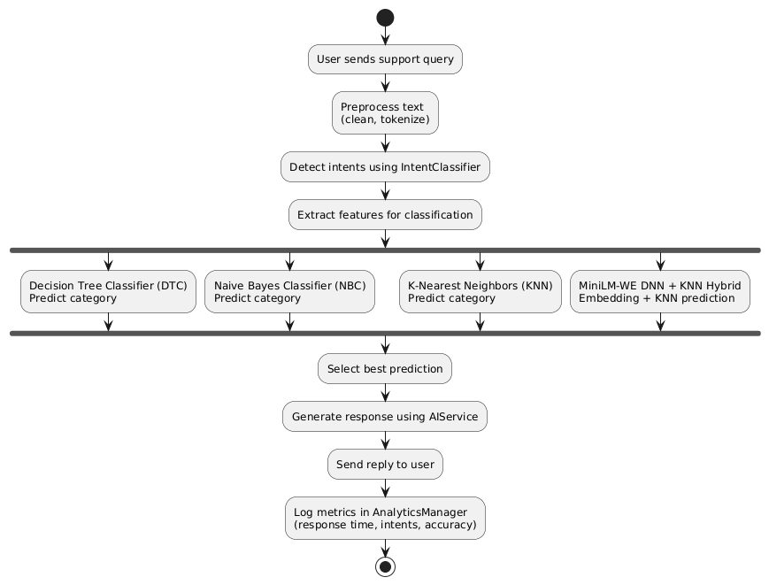
ACTIVITY DIAGRAM

Slide 17
SOURCE CODE
1. Flask Application Initialization & Setup
app = Flask(__name__)
app.secret_key = os.environ.get("SESSION_SECRET", "dev-secret-key")
CORS(app)
# Initialize AI services
ai_service = AIService()
intent_classifier = IntentClassifier()
# Initialize classifier
classifier = CustomerServiceClassifier(model_dir="model")

Slide 18
SOURCE CODE
2. Exploratory Data Analysis (EDA) Processing
@app.route('/api/eda', methods=['GET'])
def run_eda():
df = classifier.upload_dataset(train_path)
X, Y_dict = classifier.preprocess_data(df, target_cols=["intent", "category"])
eda_plot_dir = os.path.join(app.static_folder, 'eda_plots')
os.makedirs(eda_plot_dir, exist_ok=True)
classifier.eda_nlp_analysis(X, num_words=100, top_n_words=20)
classifier.plot_target_distributions(Y_dict)
return jsonify({'plots_generated': True})

Slide 19
SOURCE CODE
3. Model Training & Prediction System
@app.route('/api/predict', methods=['GET'])
def predict():
# Train model if not already trained
if not classifier.models:
classifier.fit(train_path, target_cols=["intent", "category"])
# Generate predictions
predictions_df = classifier.predict(test_path, model_base_name="MiniLM-WE DNN")
return jsonify({
'success': True,
'predictions': predictions_df.to_dict(orient='records'),
'columns': list(predictions_df.columns)
})

Slide 20
SOURCE CODE
4. AI Chat System with Intent Detection
@app.route('/api/chat', methods=['POST'])
def chat():
data = request.get_json()
user_message = data.get('message', '').strip()
detected_intents = intent_classifier.classify_intents(user_message)
ai_response = ai_service.generate_response(
user_message,
conversations.get(session.get('session_id'), []),
detected_intents
)
analytics_data['total_conversations'] += 1
return jsonify({
'response': ai_response,
'intents': detected_intents,
'timestamp': datetime.now().isoformat()
})

Slide 21
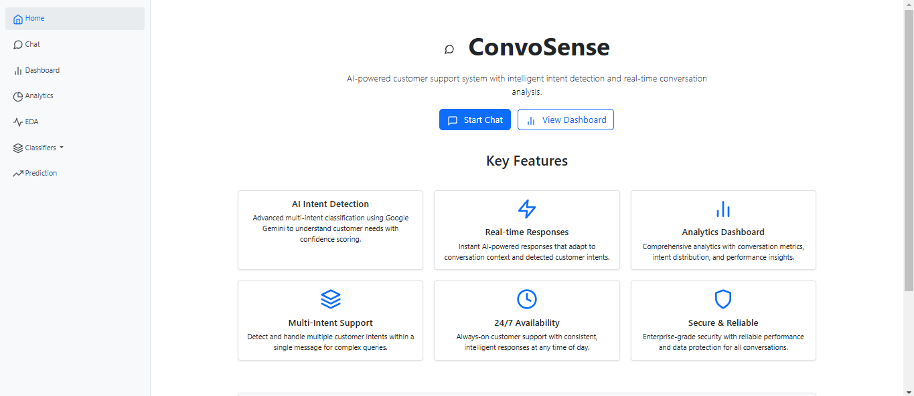
RESULTS
Home page for Multi-Intent Annotations For Conversational AI

Slide 22
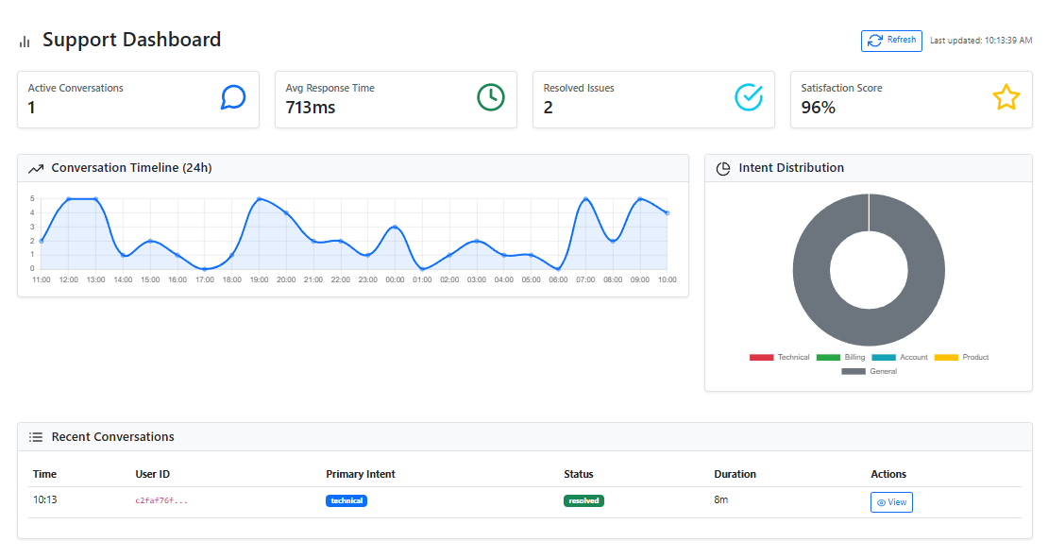
RESULTS
Real-Time AI Support Dashboard for Conversation Monitoring and Analytics

Slide 23
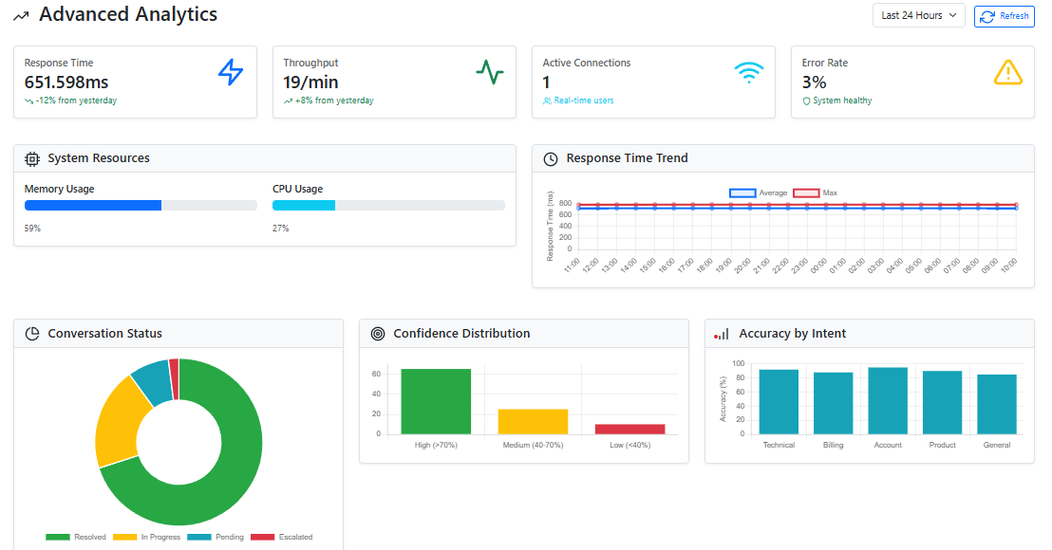
RESULTS
Advanced Analytics Dashboard for AI Support System Performance Monitoring.

Slide 24
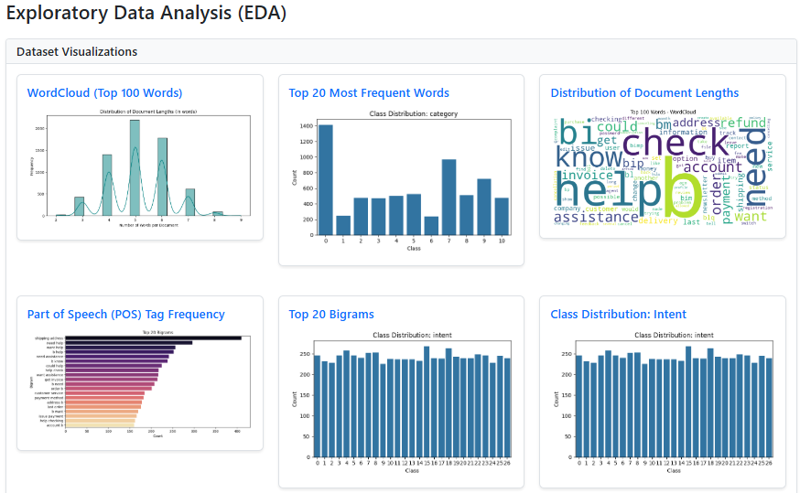
RESULTS
Exploratory Data Analysis (EDA)

Slide 25
CONCLUSION & FUTURE ENHANCEMENT
Future Enhancement
The system has significant potential for enhancement and expansion in multiple directions.
One major improvement would be the integration of context-aware conversational AI, where the model not only detects intents but also maintains contextual understanding over long multi-turn conversations.
Another future direction is the incorporation of advanced deep learning architectures, such as transformers or attention-based networks, to handle more complex user queries with better accuracy and generalization.
Conclusion
The development of the Customer Support Dataset with Multi-Intent Annotations system demonstrates the effectiveness of combining natural language processing, machine learning, and web-based frameworks for intelligent conversational AI.
By integrating multiple classifiers — including Decision Tree, Naive Bayes, K-Nearest Neighbors, and the proposed hybrid MiniLM-WE DNN-KNN model — the system can accurately detect and respond to diverse customer intents.

Slide 26
KEY REFERENCES
Huang Z, Liu H, Zhu J, Min J. Customer Sentiment Recognition in Conversation Based on Contextual Semantic and Affective Interaction Information. Applied Sciences. 2023; 13(13):7807. https://doi.org/10.3390/app13137807
Wagner N, Kraus M, Minker W, Griol D, Callejas Z. A Survey on Multi-User Conversational Interfaces. Applied Sciences. 2025; 15(13):7267. https://doi.org/10.3390/app15137267
Lin C-C, Huang AYQ, Yang SJH. A Review of AI-Driven Conversational Chatbots Implementation Methodologies and Challenges (1999–2022). Sustainability. 2023; 15(5):4012. https://doi.org/10.3390/su15054012
Bercaru G, Truică C-O, Chiru C-G, Rebedea T. Improving Intent Classification Using Unlabeled Data from Large Corpora. Mathematics. 2023; 11(3):769. https://doi.org/10.3390/math11030769

Slide 27
GITHUB LINK
Link ➜
https://github.com/Shivanigidya/Customer-support-dataset-with-multi-itent-annotations-for-conservational-AI/tree/main

Slide 28


